Slide 1
ML Model Selection
With Case Study
Presentation by Harsh Madhyan, IIT Gandhinagar

Slide 2
Part 1: ML Model Analysis

Slide 3
Linear Regression
2. Logistic Regression
Example: Titanic Dataset
Not useful, since the nature of target variable is categorical, and not continuous.
Will work fine, but not good enough. It does not automatically take into account the interaction between independent feature variables. Also, it does not construct a more efficient non-linear decision boundary, where linear separation may not be possible.
https://datascience.stackexchange.com/questions/6048/decision-tree-or-logistic-regression

Slide 4
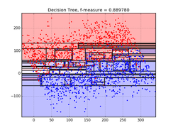
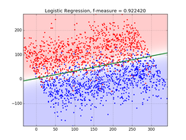
3. Decision Tree
Higher likelihood of being more accurate as a result of non-linearity and feature interaction consideration. But, is prone to overfitting and its performance is usually inferior to ensemble tree based classifiers (Bagging & Boosting).
https://blog.bigml.com/2016/09/28/logistic-regression-versus-decision-trees/

Slide 5
But how does Decision Tree work?
It uses ‘Information Gain’ to prioritize weightage to different features, to move along its depth. The feature with maximum information gain becomes the root node for further decisions.
Information gain of a feature variable is the difference of entropy before and after splitting the target variable on that feature variable.
Demerits/Shortcomings: Working with binnings, Pruning (to prevent overfitting) thus scope for accuracy improvement, inefficient in case of large number of unique attributes, cannot automatically handle missing values
https://medium.com/@rishabhjain_22692/decision-trees-it-begins-here-93ff54ef134
https://www.saedsayad.com/decision_tree.htm

Slide 6
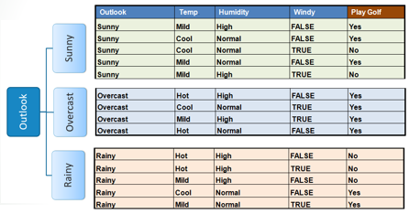
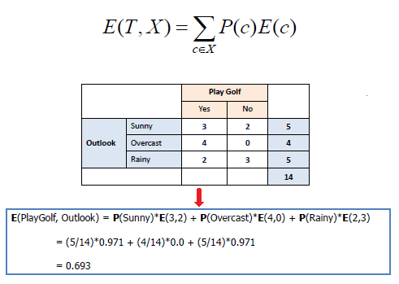
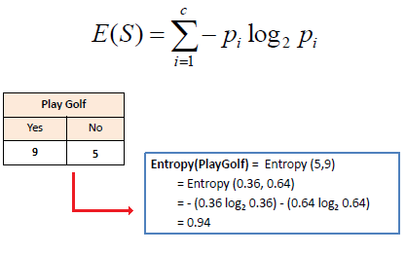
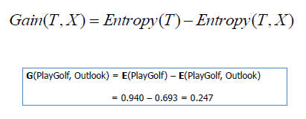

Slide 7
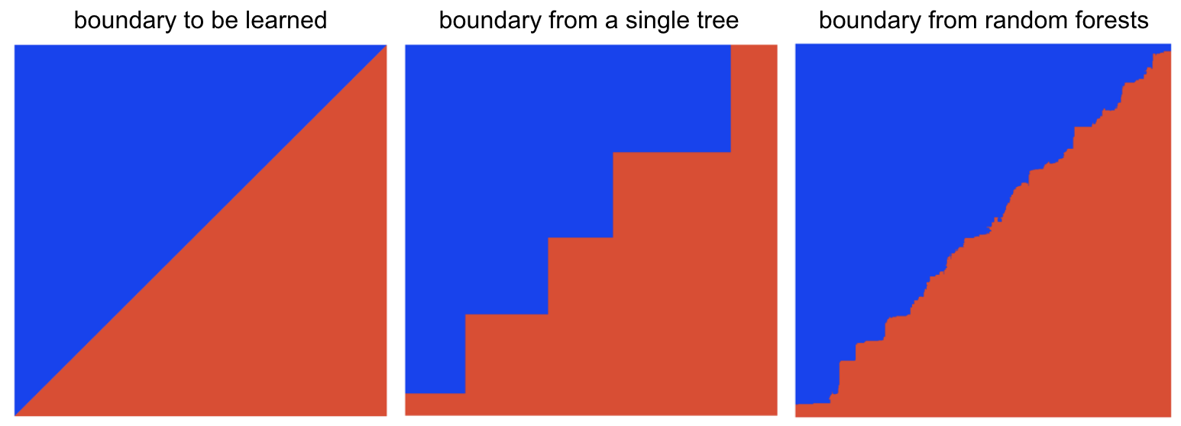
4. Random Forest
Trees in RF are unpruned, and thus feature space is split into more and smaller regions. The data sample as well as the feature set is randomly split among (voting) trees. Diversity and ‘non-overfitting’ improves performance.
https://towardsdatascience.com/why-random-forests-outperform-decision-trees-1b0f175a0b5

Slide 8
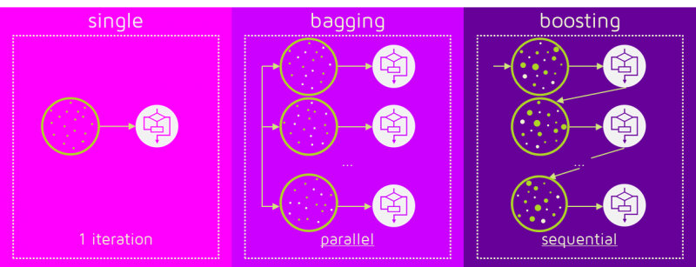
Gradient Boosted Trees
GBM is sequential and reduces error by maximizing the reduction in bias, unlike RF, which is parallel and reduces error by maximizing the reduction in variance. GBM architecture consists of one layer of weak learners followed by another, it however requires hyperparameter tuning. It generally outperforms RF. Weights of individual model is decided by its performance, in case of GBM; which in case of RF is random (simple average).
https://stats.stackexchange.com/questions/173390/gradient-boosting-tree-vs-random-forest

Slide 9
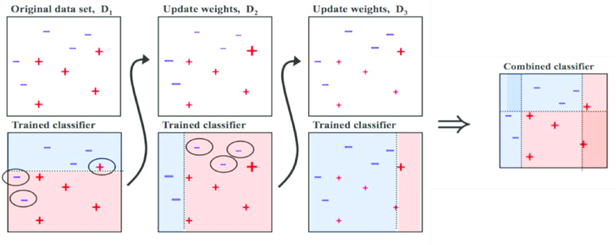
Adaptive Boosting (AdaBoost Trees)
https://www.researchgate.net/figure/Training-of-an-AdaBoost-classifier-The-first-classifier-trains-on-unweighted-data-then_fig3_306054843

Slide 10
AdaBoost versus GBM
Both are boosting algorithms which improve the performance of individual weak learners to make them strong. However, they use different techniques to achieve the same task.
GBM uses Gradient (loss minimization) by adding weak learner to a strong learner sequentially. AdaBoost assigns more weights (votes) to the targets misclassified by the models, and iterates across decision stamps, to achieve superior performance.
https://www.analyticsvidhya.com/blog/2015/11/quick-introduction-boosting-algorithms-machine-learning/
https://www.quora.com/What-is-the-difference-between-gradient-boosting-and-adaboost

Slide 11
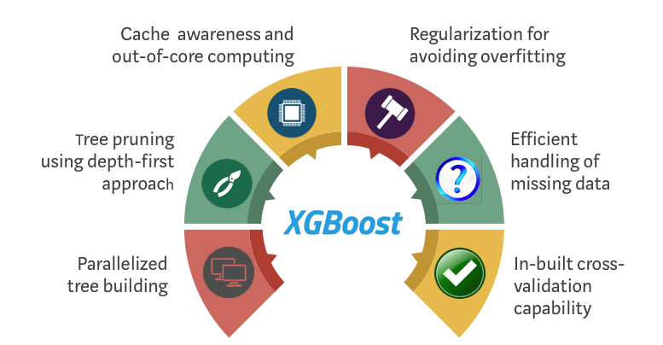
Extreme Gradient Boosting (XGBoost)
Its main features are high execution speed, owing to parallelization of operation, preventing overfitting and making efficient use of memory. It works on only numeric data, has the ability to deal with missing values and is scalable (same model) to new data.

Slide 12
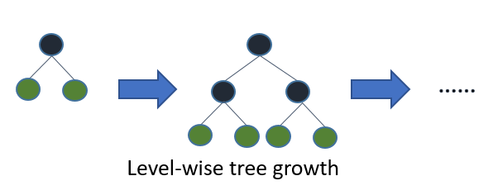
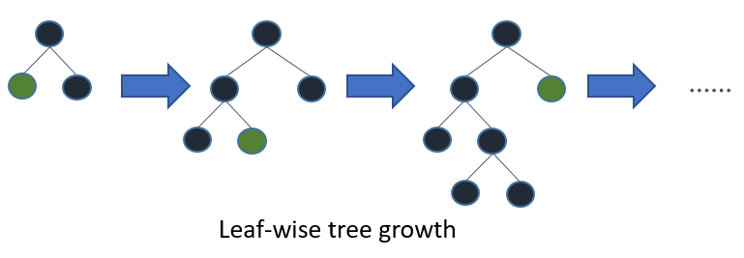
Light Gradient Boosted Machine (LightGBM)
It can handle categorical values. It works faster even without one hot encoding them. But categorical values need to be converted to int type before passing into it. It supports Parallel Learning and outperforms all other boosting methods, both in terms of speed and accuracy, most of the time, because of the complex leaf wise tree growth. It is prone to overfitting, but can be controlled by max-tree depth parameter.
XGBoost (less prone to overfitting)
LightGBM (more complex, but superior)
https://www.analyticsvidhya.com/blog/2017/06/which-algorithm-takes-the-crown-light-gbm-vs-xgboost/
https://www.quora.com/How-does-the-LightGBM-algorithm-work-conceptually

Slide 13
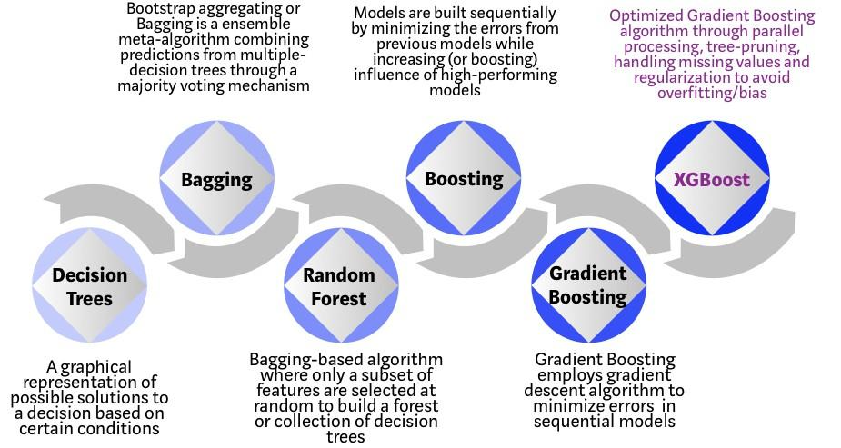
Summary
https://towardsdatascience.com/https-medium-com-vishalmorde-xgboost-algorithm-long-she-may-rein-edd9f99be63d

Slide 14
SVM, Naive Bayes and KNN
Support Vector Machine
Generally preferred where sparsity is high (example in document classification), and where the dataset size and number of features is near million. It uses kernel trick to shrink the dimensionality and deduce non-linear relations via. Decision boundary
Naive Bayes
It assumes the features to be completely independent (0 corr), but works well many times. It requires less data and time for even relatively high accuracy. It can adapt to new data easily, and is preferred for text data (only) most of the time.
KNN
Preferred when distribution of the data is not known well. Requires feature scaling. Hardly ever outperforms other models. Very sensitive to outliers and choice of features. Not scalable.
https://discuss.analyticsvidhya.com/t/how-to-decide-when-to-use-naive-bayes-for-classification/5720/3
https://www.researchgate.net/post/When_we_use_Support_Vector_machine_for_Classification

Slide 15
Part 2: Case Study

Slide 16
Now, for our case - Titanic Dataset
Problem
Data
Based on their personal characteristics and the conditions dictated by the situation at the ship, determine whether or not a person with given attributes will survive the tragedy.
891 people (training) and 11 features; 418 people (test set); 34 KB data

Slide 17
Feature Set Analysis (Binary Classification)
Feature Name | Type
Passenger ID | Integers
Name | Non-Numeric
P Class | Numeric Categorical
Sex | Non-Numeric Categorical
Age | Numeric
No. of siblings | Numeric
No. of parents/Child | Numeric
Ticket Number | Char + Numeric
Fare | Numeric
Cabin Number | Char + Numeric
Embarkation Port | Non-Numeric Categorical
Target Variable | Type
Survived | Numeric Categorical

Slide 18
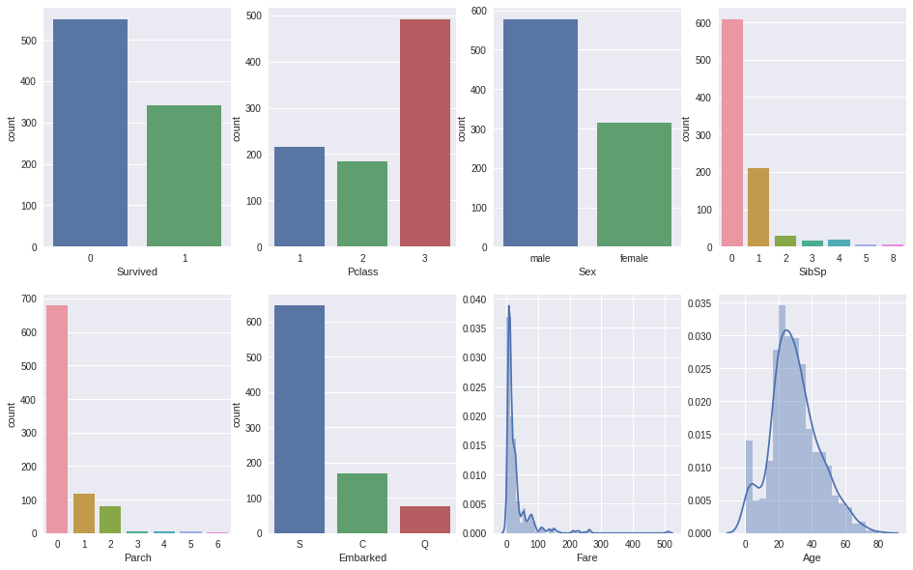
EDA

Slide 19
Qualitative Data Interpretation and Analysis
Once we one hot encode the categorical features, we end up with little over 40 features. With little EDA, we can easily deduce that the data is no where near linearly separable. Also, assuming the features to be completely independent is far from realistic. For example, Fare and Cabin location are even intuitively correlated. These facts, along with earlier stated theory, rule out KNN, Naive Bayes, Logistic Regression, Decision Tree; and suggests strong probability of high performance of SVM and other bagging and boosting methods
Further, accuracy can be improved using Stratified K-Fold Cross Validation owing to the somewhat imbalanced dataset (see EDA), Randomized Search CV for tuning, and finally, appropriately ensembling the top performing models.
For the remaining models, their performance can be only known by actually running on the dataset and using cross-validation. Other techniques could include, but not limited to, selection of only the best features for a model, different imputation strategies for missing values (eg: Age), binning followed by numerical category, deploying different types of ensembling - Weighted Voting, Superlearner, Stacking or Blending.

Slide 20
On Ensembles, and their working
Ensembles make a set of classifiers learn simultaneously and combines their prediction. Quite intuitively, it reduces bias as well as variance, as a result of prediction votes from diverse classifiers.
For instance, if there are 25 base classifiers, with each classifier having error rate of 0.35 (say), then, the ensemble (i.e. our final model) makes a wrong prediction only if majority of the classifiers constituting the ensemble make a wrong prediction, which has a very low error rate. Using Bernoulli Principle, the probability that 13 or more classifiers predict wrongly is just 0.06.
http://www.ke.tu-darmstadt.de/lehre/archiv/ws0910/mldm/ensembles.pdf

Slide 21
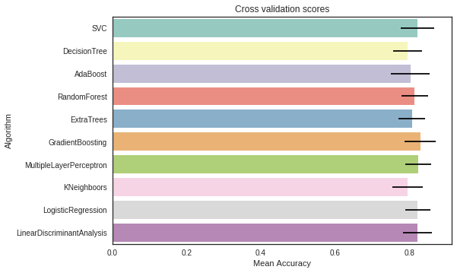
Performance Results (in line with previous discussion)
https://www.kaggle.com/yassineghouzam/titanic-top-4-with-ensemble-modeling/data

